Slide 1

Data – FAIR, Open and Version Controlled
Dr Ryan Field

Slide 2
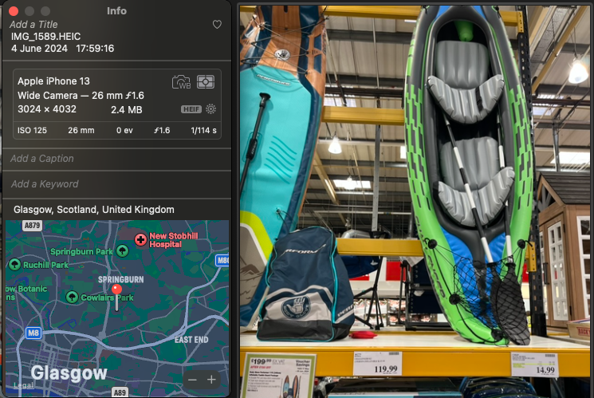
Data / Metadata
Data – Information collected for use
Metadata – Information that describes data
Cambridge Dictionary
Notes:
Image – Composite type of data

Slide 3




What is FAIR Data
Findable
Accessible
Interoperable
Reusable
Wilkinson, M., Dumontier, M., Aalbersberg, I. et al. The FAIR Guiding Principles for scientific data management and stewardship. Sci Data 3, 160018 (2016). https://doi.org/10.1038/sdata.2016.18
Notes:
Metrics available such as Research Data Alliance (RDA)

Slide 4
Findable
Data should be easy to find by humans and computers
Data should be well described with metadata
Data should be identified by a unique persistent identifier
Data should be registered / indexed in a searchable resource
Wilkinson, M., Dumontier, M., Aalbersberg, I. et al. The FAIR Guiding Principles for scientific data management and stewardship. Sci Data 3, 160018 (2016). https://doi.org/10.1038/sdata.2016.18

Slide 5
Unique Identifiers – DOI’s
DOI – Digital Object Identifier
Unique identifier for any digital object
E.g., Data / Scientific Article
Manage by the doi foundation – doi.org
‘Home Page’. Accessed: Jun. 03, 2024. [Online]. Available: https://www.doi.org/

Slide 6
Registering Data
Many ways of registering data
Including:
Zenodo – Datasets / Software
PANGAEA – Georeferenced data from earth system research.
Both index metadata and provide object identifiers
Notes:
Pangaea - georeferenced data from earth system research

Slide 7
Accessible
Data / Metadata should be easy to access
Using standard file formats
Metadata should remain available after data are no longer available
FAIR ≠ Open
Allows for authentication prior to access
Wilkinson, M., Dumontier, M., Aalbersberg, I. et al. The FAIR Guiding Principles for scientific data management and stewardship. Sci Data 3, 160018 (2016). https://doi.org/10.1038/sdata.2016.18

Slide 8

Open Data
“Open data and content can be freely used, modified, and shared by anyone for any purpose” https://opendefinition.org/

Slide 9
Interoperable
Data usually needs to be integrated with other data
Data / metadata should use a formal and accepted format / standard
Should also use recognized vocabulary
E.g., ISO / W3C / Schema.org
Should include qualified references to other data / metadata
Wilkinson, M., Dumontier, M., Aalbersberg, I. et al. The FAIR Guiding Principles for scientific data management and stewardship. Sci Data 3, 160018 (2016). https://doi.org/10.1038/sdata.2016.18
Notes:
International Standards Organization – ISO
W3C – World Wide Web Consortium (W3C)

Slide 10
Reusable
Data should be well described so that they can be replicated or combined in different settings
Data / metadata described with accurate and relevant attributes
Data / metadata should be clearly licensed to allow for reuse
This can be a permissive / restrictive license
Wilkinson, M., Dumontier, M., Aalbersberg, I. et al. The FAIR Guiding Principles for scientific data management and stewardship. Sci Data 3, 160018 (2016). https://doi.org/10.1038/sdata.2016.18
Notes:
International Standards Organization – ISO
W3C – World Wide Web Consortium (W3C)

Slide 11
Reusable
Data / metadata should be associated with clear provenance
Data / metadata should meet domain-relevant accepted standards – Ocean best practices
Wilkinson, M., Dumontier, M., Aalbersberg, I. et al. The FAIR Guiding Principles for scientific data management and stewardship. Sci Data 3, 160018 (2016). https://doi.org/10.1038/sdata.2016.18
Notes:
International Standards Organization – ISO
W3C – World Wide Web Consortium (W3C)

Slide 12
Data Provenance
Documenting the process(es) that produced the data
How was the data collected / generated / derived
Original data
Data manipulation
What methods were used
W3C - PROV
S. N. Mitchell et al., ‘FAIR data pipeline: provenance-driven data management for traceable scientific workflows’, Philos. Trans. R. Soc. Math. Phys. Eng. Sci., vol. 380, no. 2233, p. 20210300, Aug. 2022, doi: 10.1098/rsta.2021.0300.

Slide 13
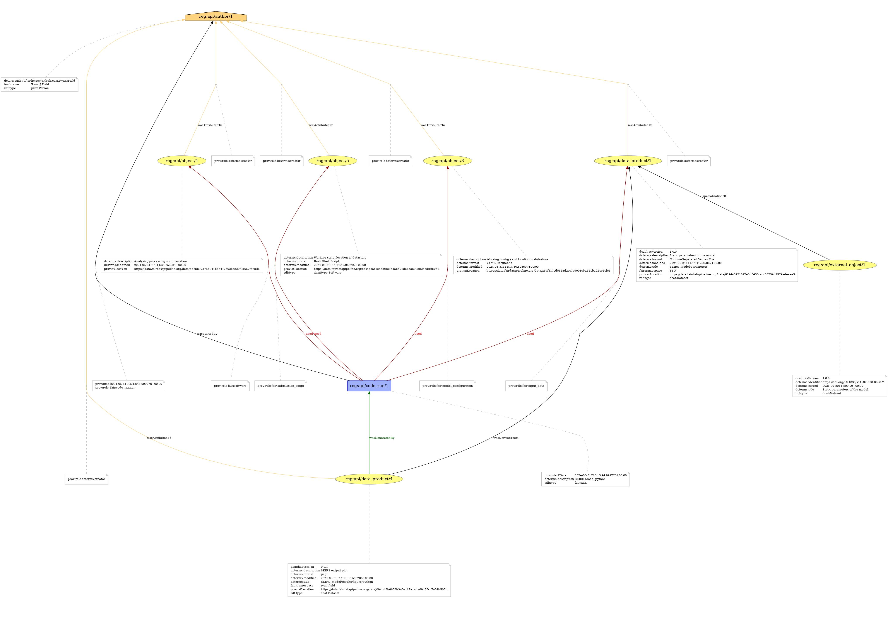

Slide 14
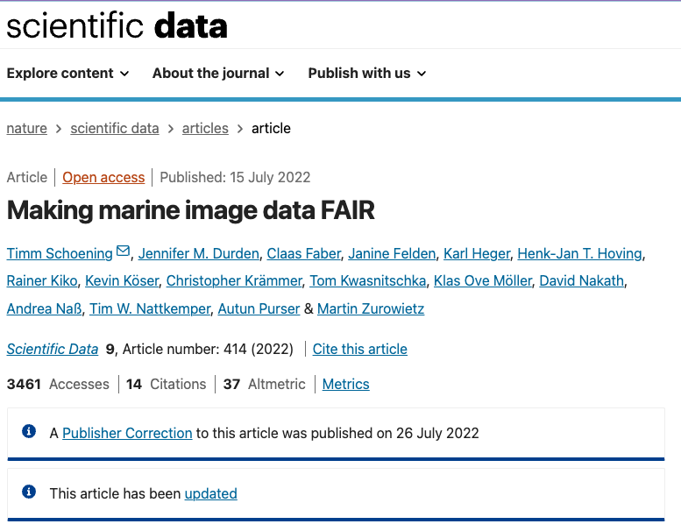
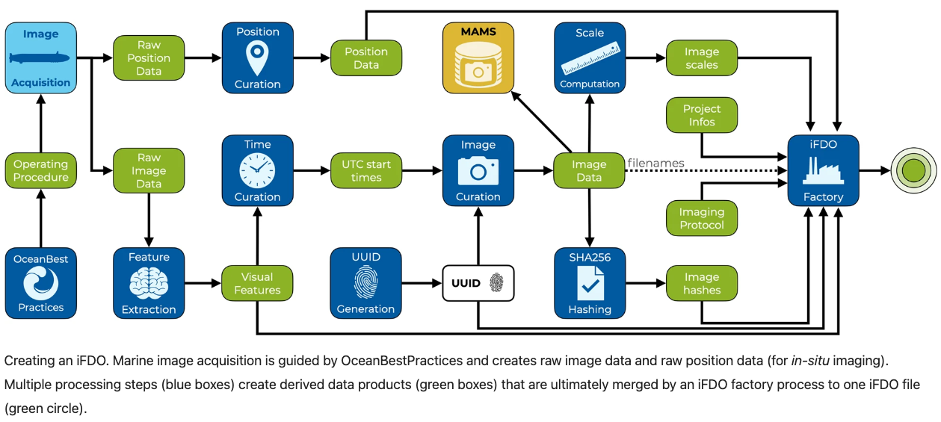
iFDO – Image FAIR DIGITAL OBJECTS
T. Schoening et al., ‘Making marine image data FAIR’, Sci. Data, vol. 9, no. 1, p. 414, Jul. 2022, doi: 10.1038/s41597-022-01491-3.
Notes:
RDA – Checklist
MAMS - Media Asset Management System - PANGAEA

Slide 15
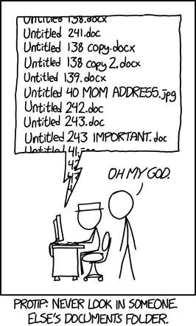
Version Control
A way of managing different versions of files
Manually
Version Control Systems
Distributed – e.g., Git
Centralized – e.g., Subversion (SVN)
Source: xkcd.org under creative commons
‘Git - About Version Control’. Accessed: Jun. 03, 2024. [Online]. Available: https://git-scm.com/book/en/v2/Getting-Started-About-Version-Control

Slide 16

Open-source software
Developed by Linus Torvalds (creator of Linux) in 2005
Distributed version control
Designed for
Speed
Simple design
Non-linear development (Branches)
Ability to handle large projects
‘Git - A Short History of Git’. Accessed: Jun. 03, 2024. [Online]. Available: https://git-scm.com/book/en/v2/Getting-Started-A-Short-History-of-Git
Notes:
Due to BitKeeper

Slide 17
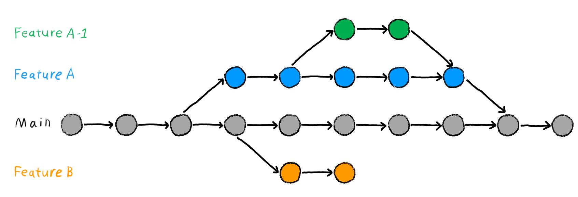
Branches
Source https://the-turing-way.netlify.app/reproducible-research/vcs/vcs-git-branches.html Under CC-BY license

Slide 18
Common git Commands
init - initialises a git repository
add – adds files to be tracked
commit – commit changes to the repository
checkout – used to change branches
clone – clone a repository from a remote server e.g., GitHub
fetch / pull get changes from remote server
push – push changes to remote server
status – view the status of the git repository
‘Git - Reference’. Accessed: Jun. 03, 2024. [Online]. Available: https://git-scm.com/docs

Slide 19
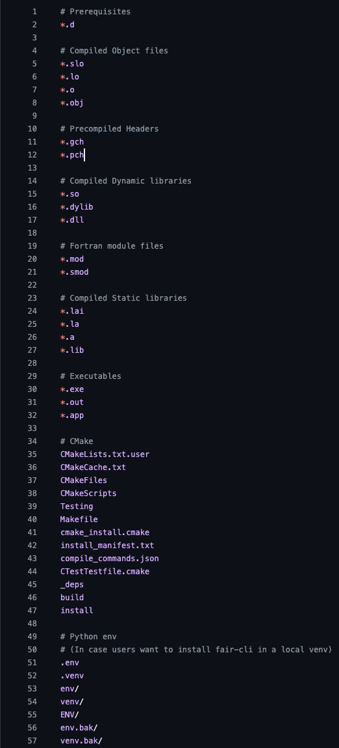
.gitignore
You may not wish to track all your files using git
For example:
Sensitive information / data
Large data
You can use the .gitignore file to ignore these files
By extension
By name
https://github.com/github/gitignore

Slide 20
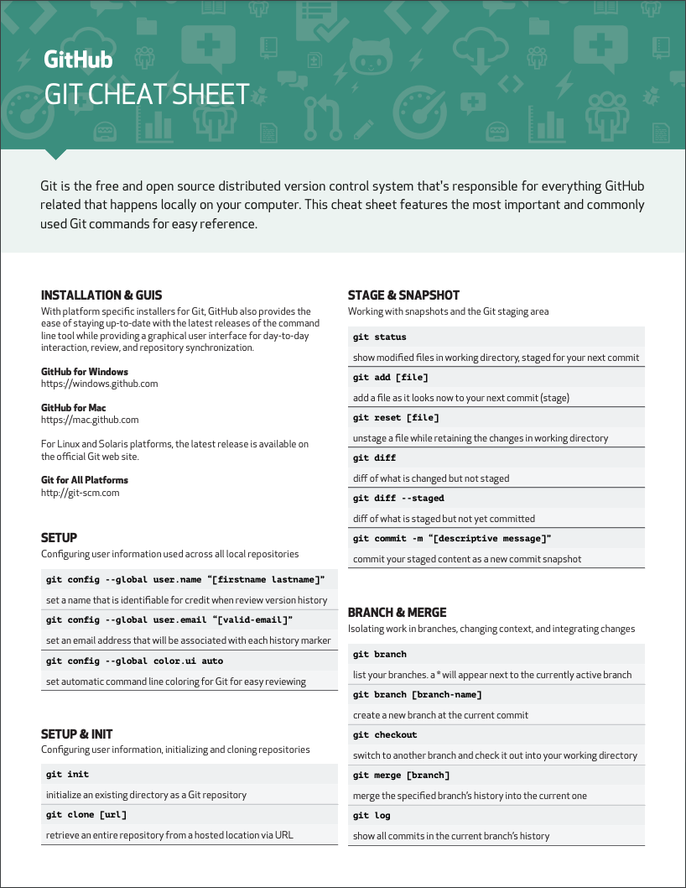
https://education.github.com/git-cheat-sheet-education.pdf

Slide 21

‘Free’ cloud-based git repository hosting service
Integrates with git – Git clone / fetch / pull
Has an online user interface (including visual studio code).

Slide 22
Practicals
https://bit.ly/MAF-1 – Practical 1
https://bit.ly/MAF-2 – Practical 2
https://bit.ly/MAF-Trouble – Troubleshooting
https://bit.ly/MAF-Advanced – Advance Practical

Slide 23
Git Clients – With a Graphical User Interface
Sourcetree (Mac / Windows) https://www.sourcetreeapp.com/
GitHub Desktop (Mac / Windows) https://desktop.github.com/
TortoiseGit (Windows) https://tortoisegit.org/

Slide 24





Thank you Any Questions? ryan.field@glasgow.ac.uk
#UofGWorldChangers
@UofGlasgow

